Slide 1
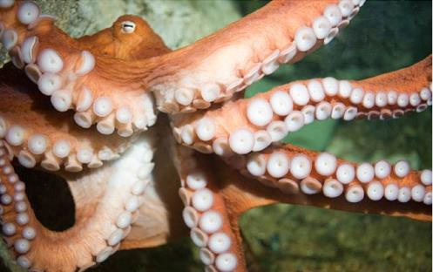
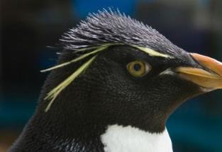
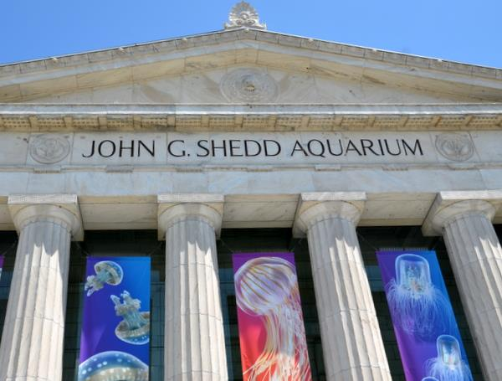
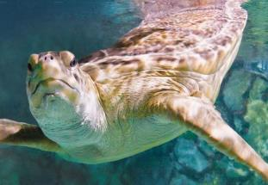
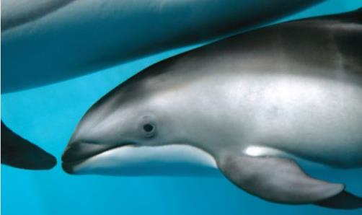
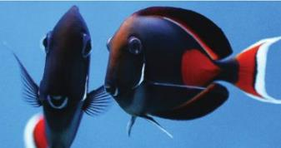
Jellies: Brand, Experience & Audience Insight
September 2014
Notes:
Shedd Background
Building Shots
Animal Shots
32000 animals
1500 species

Slide 2
Brand Overview & Philosophy

Slide 3
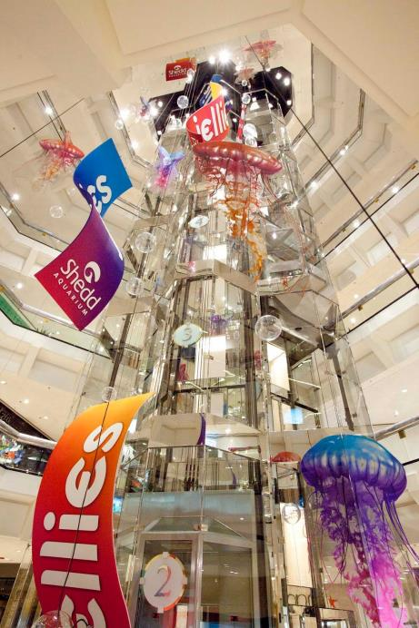
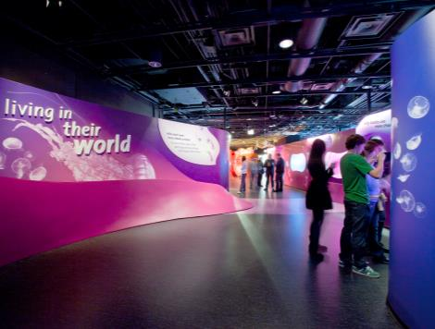
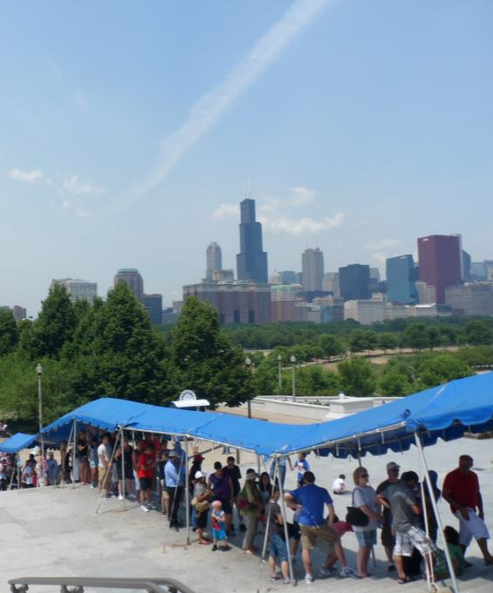
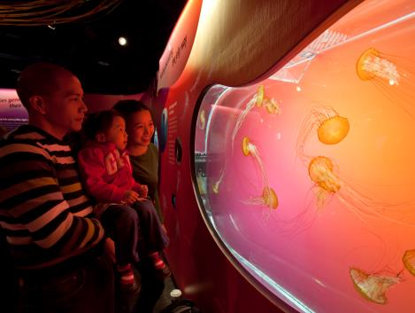
Role of the special exhibit
Notes:
Reflect the aquarium’s mission by connecting guests to the living world
Drive traffic to the aquarium by offering something new and unusual, creating a “must-see” in our target markets
Provide a guest experience that allows for flow through the space and can accommodate sufficient numbers of visitors
Offer an opportunity to temporarily expand the animal collection with unusual species and practices that allow Shedd to continue the reputation of first-class animal care

Slide 4
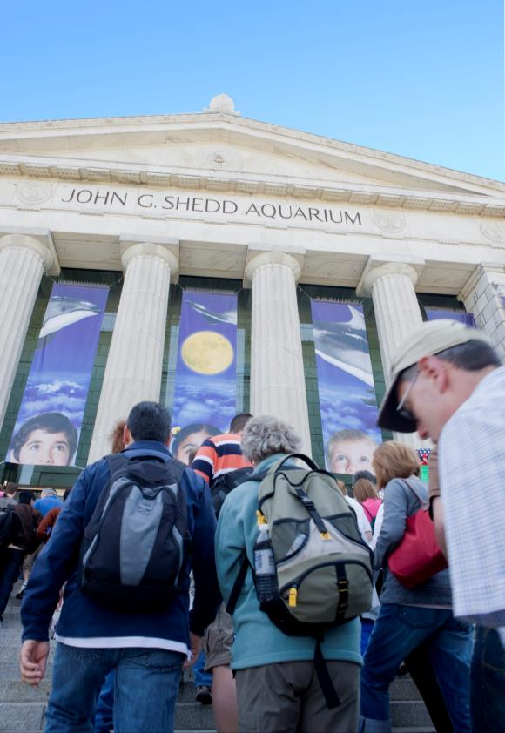
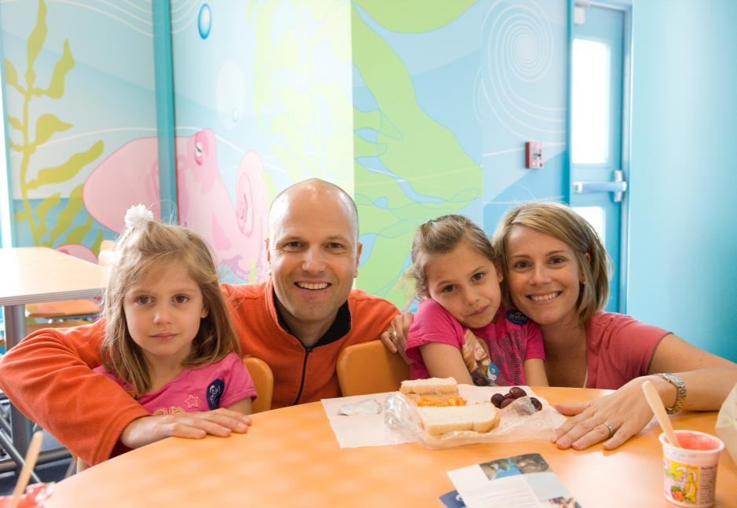
Audience Insight
Notes:
Reflect the aquarium’s mission by connecting guests to the living world
Drive traffic to the aquarium by offering something new and unusual, creating a “must-see” in our target markets
Provide a guest experience that allows for flow through the space and can accommodate sufficient numbers of visitors
Offer an opportunity to temporarily expand the animal collection with unusual species and practices that allow Shedd to continue the reputation of first-class animal care

Slide 5
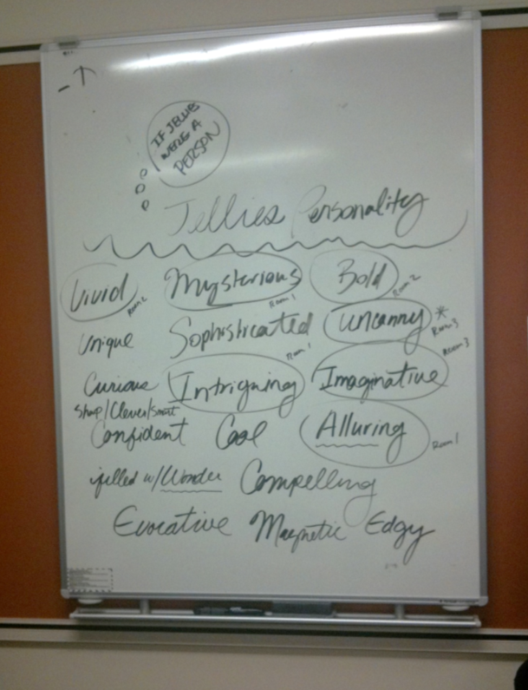
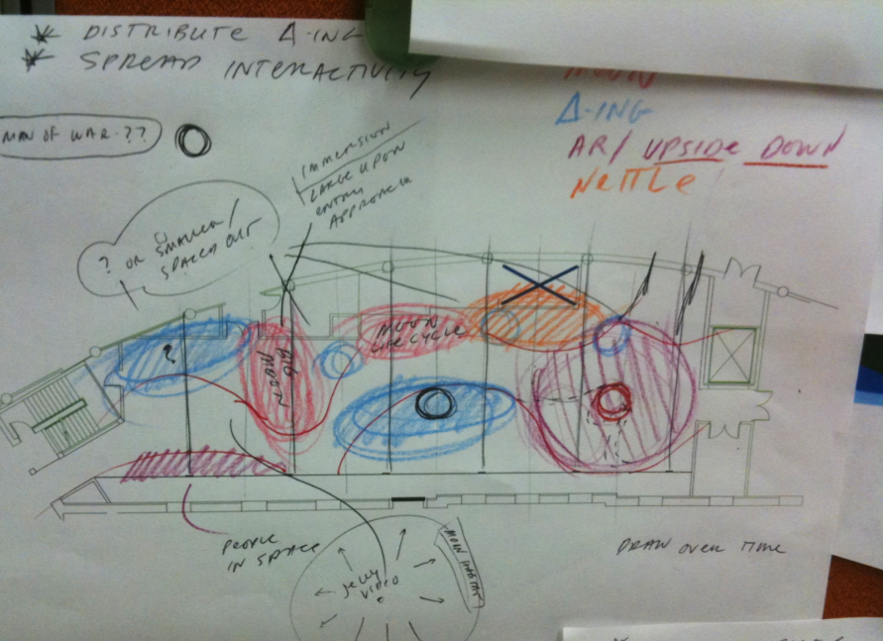
Special Exhibit Process

Slide 6
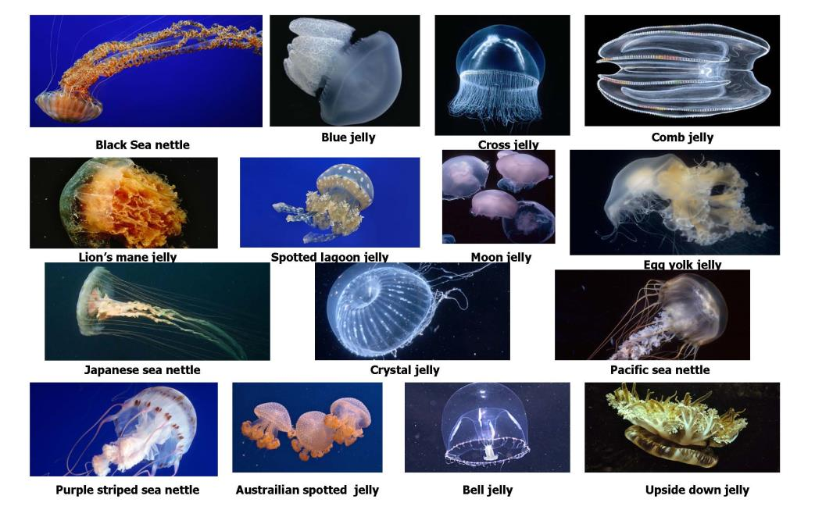
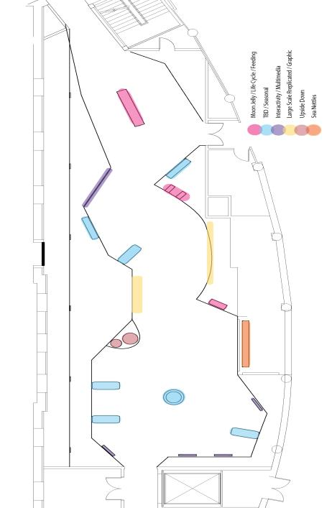
Special Exhibit Process

Slide 7
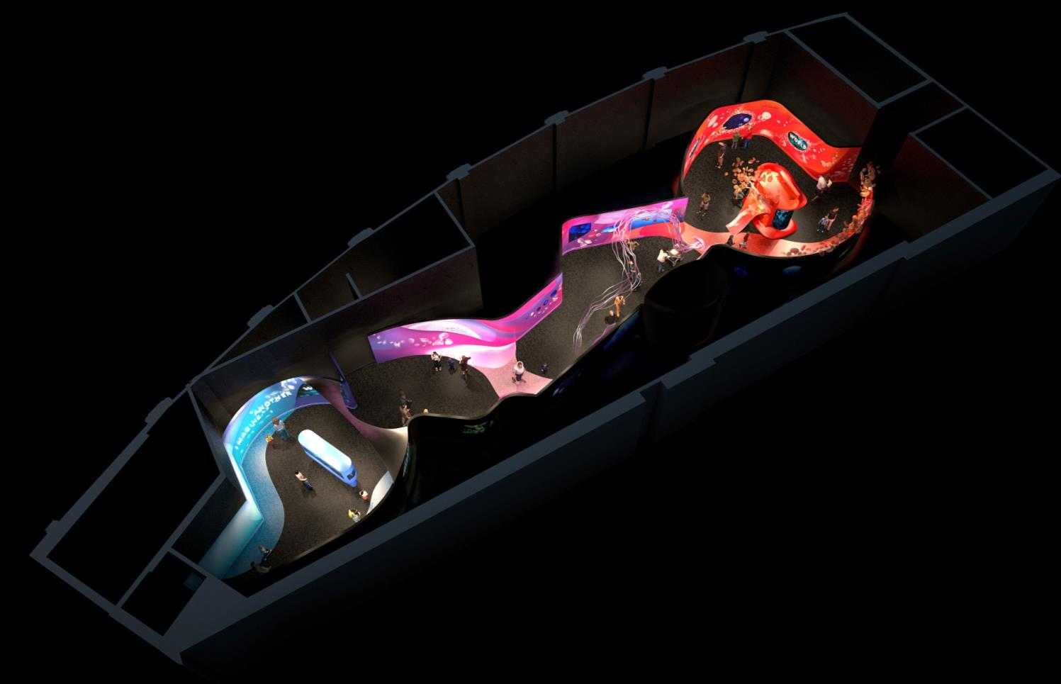
Special Exhibit Process

Slide 8
Marketing Process

Slide 9
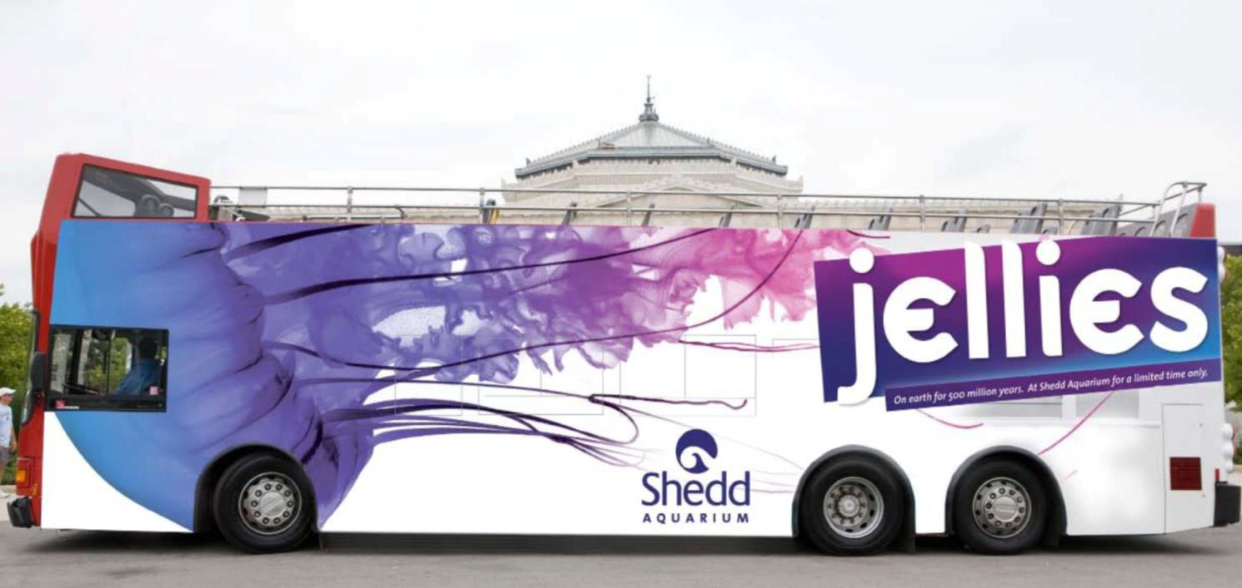
Marketing Process

Slide 10
Video

